Slide 1




Smart Drought Response: AI Ranking for High‑Risk Counties
Team Geek Squad - Juwan Johnson, Karim Stack, Joshua Parker, Carelle Ngadeu, Jeremiah Drummond

Slide 2




Problem Statement
() Traditional drought triggers like rainfall deficits often miss the counties experiencing real crop losses, slowing emergency relief decisions.
() We built a data‑driven county ranking and trigger system trained on 2000–2015 and validated on 2016–2025 to reliably identify high‑risk areas.
() Our Streamlit dashboard gives state officials a fast, clear way to target drought assistance with greater accuracy and confidence.

Slide 3

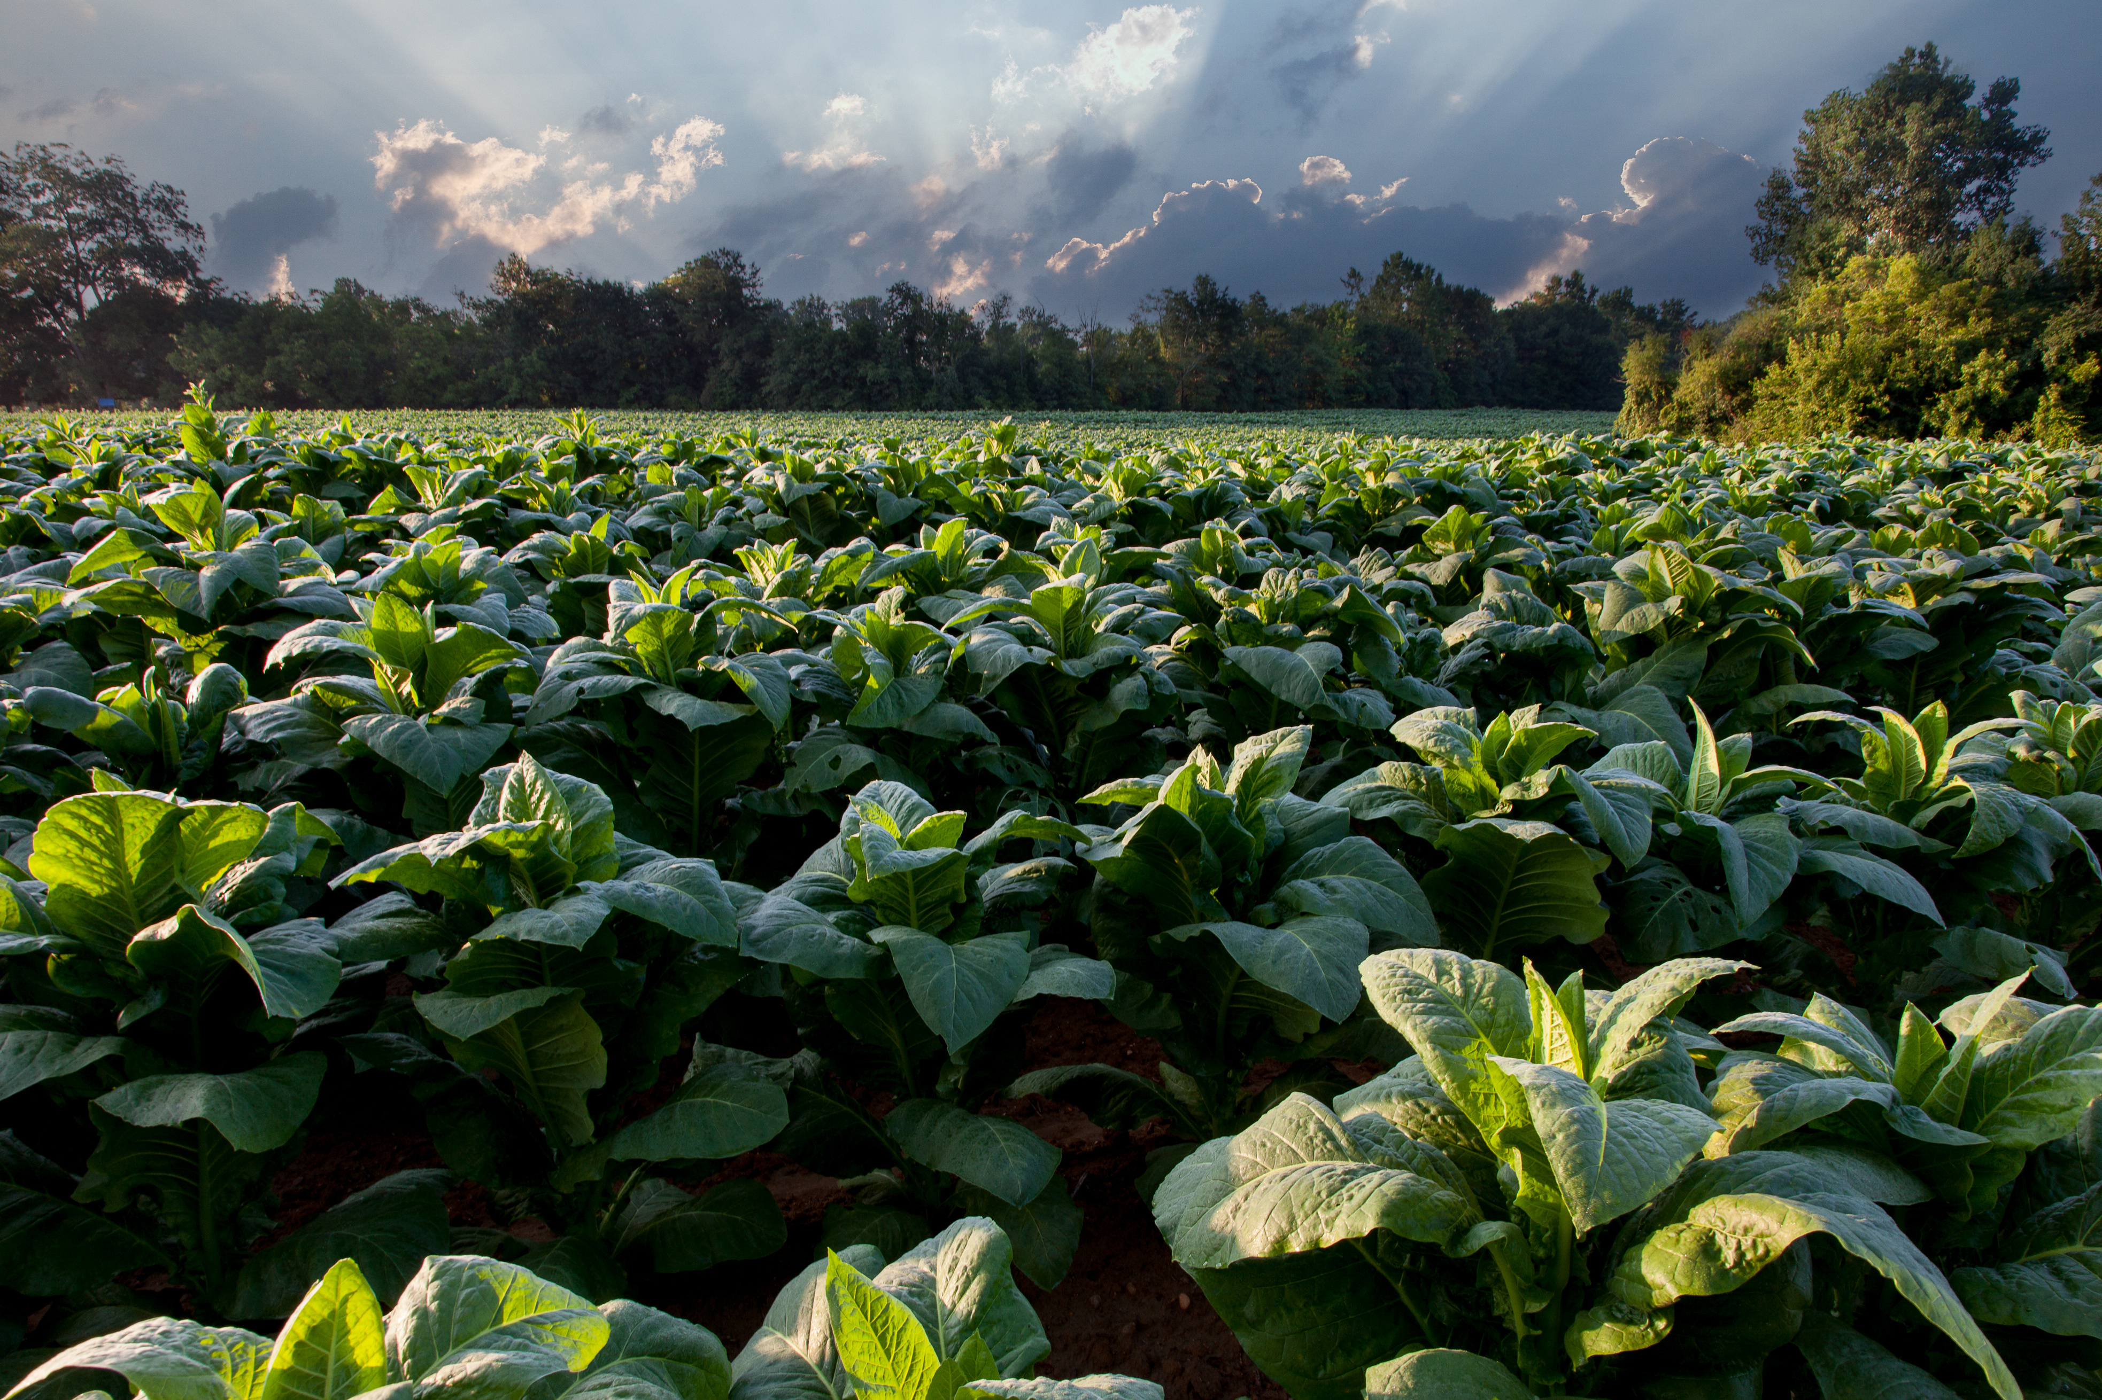

Direction:
Drought Relief Prioritization System
() Helps identify which counties need emergency drought relief first
() Uses historical data to rank counties by drought-related crop losses
() Provides clear thresholds for when assistance should begin

Slide 4

State Drought Program officials must decide...
() Which counties should receive funding first
() What metric or threshold triggers assistance
() Which counties face the most urgent drought-related losses

Slide 5

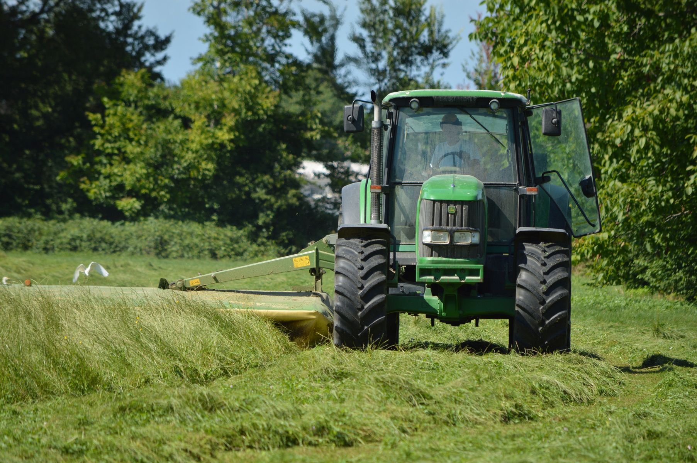
Success looks like...
Evidence-based and structured drought relief:
() County report cards show historical drought conditions and crop yield losses
() A ranking model developed using 2000–2015 data identifies severe yield losses in unseen data from 2016–2025
() Rankings outperform simpler approaches, such as random allocation or prioritizing rainfall shortages alone
() An interactive Streamlit dashboard lets officials explore county rankings, historical trends, and assistance thresholds without writing code

Slide 6

Develop a ranking model to prioritize counties for emergency funding
Build county report cards using historical drought and crop yield data
Start --> Go Further
Test their performance on unseen data from 2016–2025 and compare them with simpler approaches
Develop rankings using 2000–2015 data
Add precise assistance thresholds and show which counties meet them
Display county rankings and historical trends in a Streamlit dashboard

Slide 7
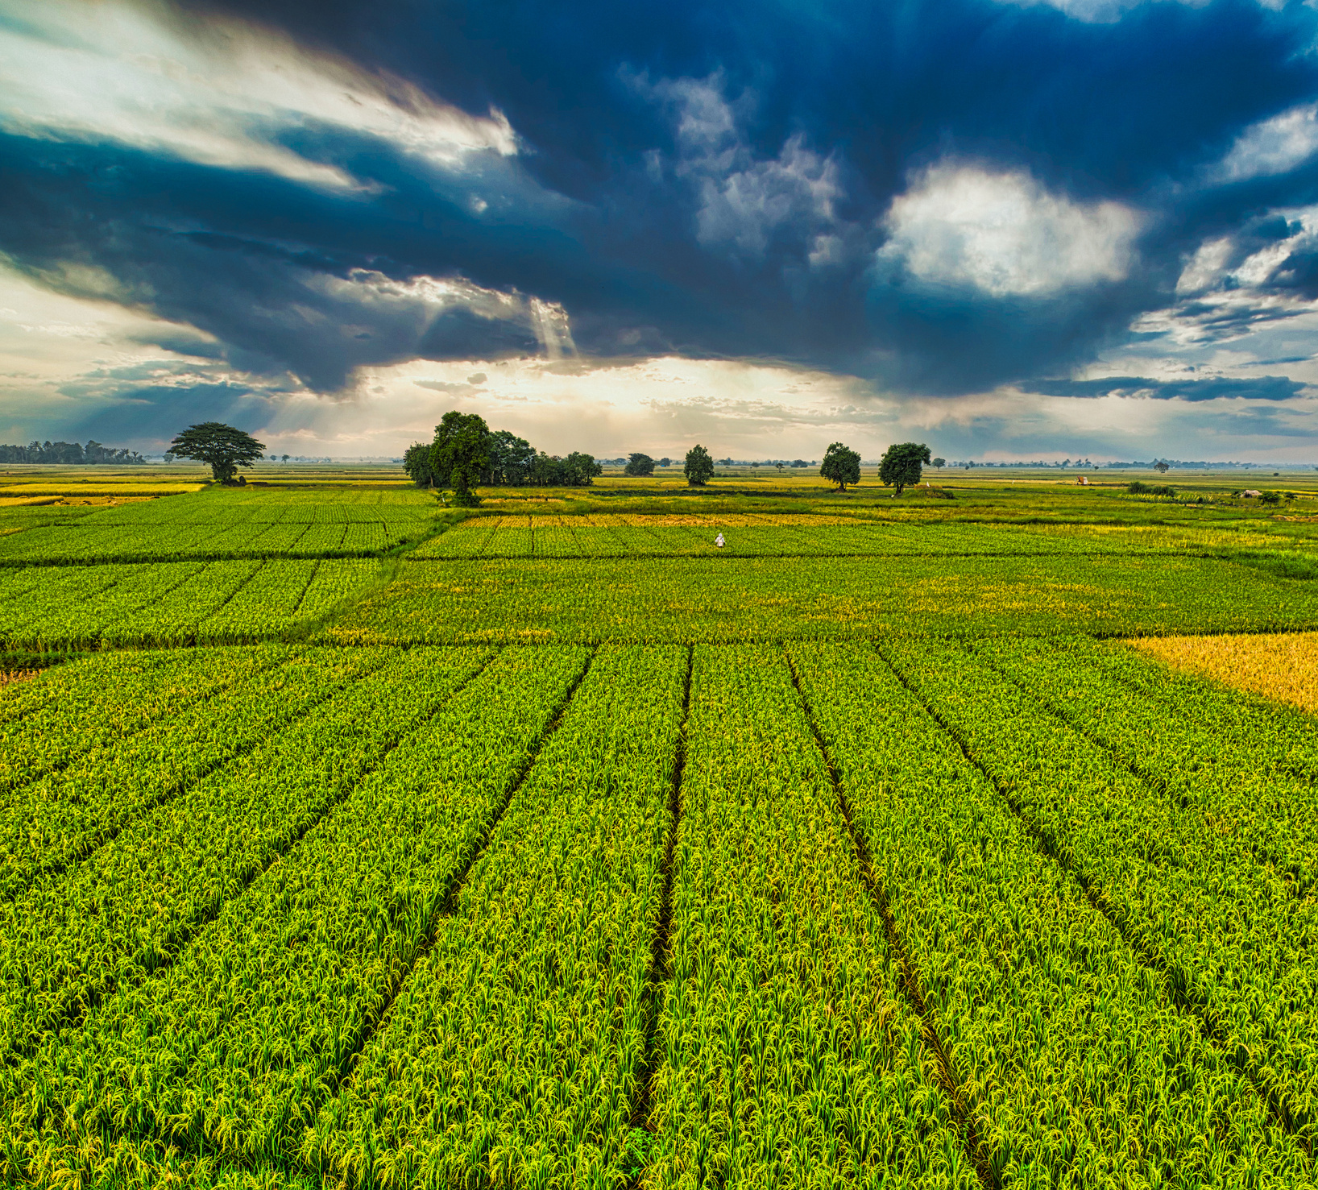
Ex. User : Dana Mitchell
State Drought Relief Coordinator
() Works for a state agricultural agency and coordinates emergency drought assistance
() Has a limited relief budget and needs to decide which counties receive funding first
() Must explain funding recommendations to agency leadership and county agricultural offices
() Needs clear evidence and an easy-to-use dashboard—not a tool that requires coding

Slide 8

How our tool helps
() Provides a report card for each county showing historical drought conditions and crop losses
()Ranks counties using a method checked against years not used to develop it
() Shows which counties meet the proposed assistance threshold
() Makes the evidence behind each recommendation visible so Dana can explain her decisions

Slide 9

Demo
https://ms-cc-org.github.io/DSU-Hackathon-2026-Geek-Squad/

Slide 10
Thank You!
Questions?

